Slide 1


Mental health assistance
Team Members:
1. Sweksha Gupta, 500105260, Semester 5, AIML (Hons.)
2. Shreyashi Manik Srivastava, 500107228, Semester 5, AIML (Hons.)

Slide 2


Content
Abstract
Introduction
Literature Review
Problem Statement
Motivation
Objective
Methodology
Applications
Conclusion
References

Slide 3
Abstract
1. AI-Powered Personalization: The platform uses advanced AI, NLP, and machine learning to assess mental health, identify patterns, and offer tailored support and recommendations.
2. Comprehensive Data Integration: Integrates with wearable devices, health records, and other sources to create a detailed mental health profile for each user, enabling targeted interventions.
3. Empowerment and Accessibility: Aims to empower individuals to manage their mental health, reduce anxiety and depression, and improve overall well-being through accessible, stigma-free support.
4. Revolutionizing Mental Health Care: The platform combines user-centered design with evidence-based methods to enhance the effectiveness, efficiency, and compassion of mental health care.

Slide 4
Introduction
1. Mental Health Crisis: Mental health disorders, particularly anxiety and depression, affect one in four individuals annually, yet access to timely, effective care remains limited due to barriers like stigma and lack of resources.
2. Barriers to Care: Many individuals struggle with accessing personalized mental health support, facing challenges such as limited resources, stigma, and inadequate tailored interventions.
3. AI as a Solution: Advances in AI, machine learning, and natural language processing offer promising solutions to deliver personalized, accessible, and stigma-free mental health support on a large scale.
4. Personalized Mental Health Assistant: Leveraging AI, the Personalized Mental Health Assistant aims to bridge gaps in care, offering individuals a non-judgmental space for support, progress tracking, and connecting with resources or professionals.

Slide 5
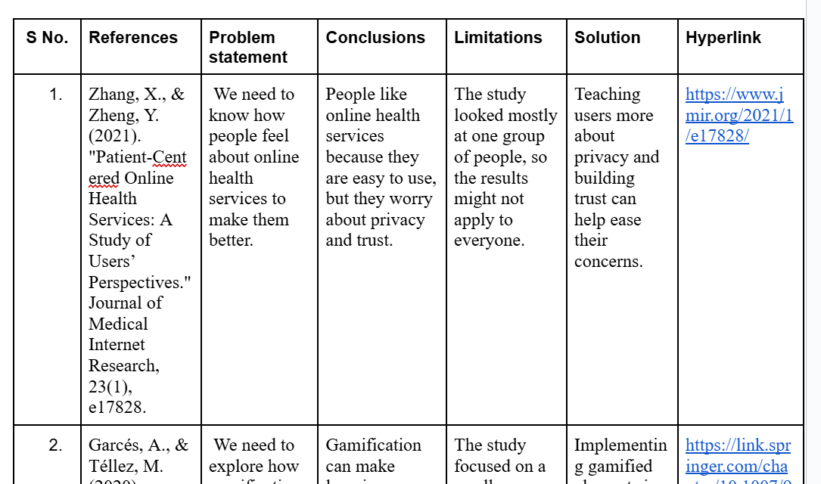
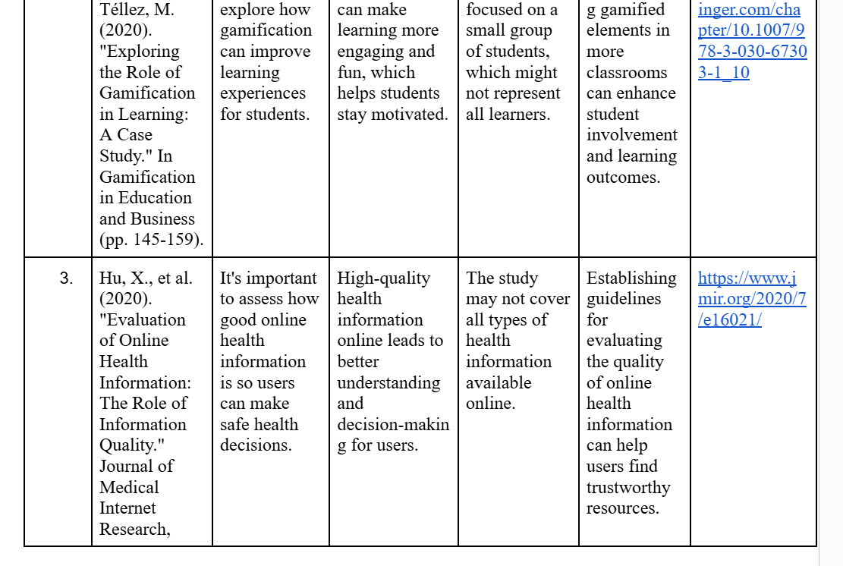
Literature Review

Slide 6
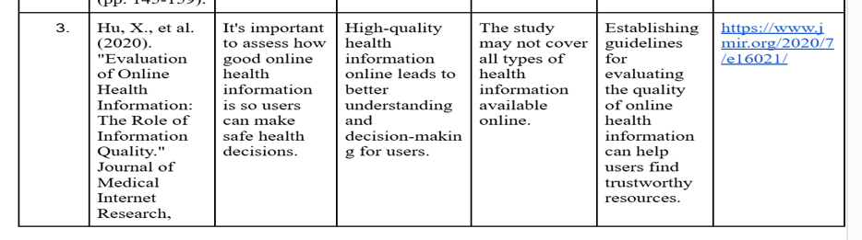
Literature Review

Slide 7
Problem Statement
The rise in mental health issues, exacerbated by societal pressures and global crises, emphasizes the need for accessible support systems. Many individuals may not realize they need help or may find it challenging to seek assistance.
This project aims to create a mental health chatbot that engages users through conversation, assesses their mental health status, and provides guidance on whether they should seek immediate help or if they are generally stable.

Slide 8
Objective
1. Interactive Chatbot: Develop a conversational AI that engages users to assess their mental health through real-time dialogue.
2. Mental Health Assessment: Use responses to identify mental health issues and assess the urgency of the user's situation.
3. Personalized Recommendations: Provide tailored suggestions, including self-help resources or referrals to professionals based on the assessment.
4. Continuous Improvement: Leverage machine learning to analyze user interactions and refine the chatbot’s responses over time.

Slide 9
Methodology
1. Surveys:
- Design structured surveys with mental health and demographic questions.
- Use Likert scales and open-ended questions for detailed insights.
2. Online Dataset:
- Download and preprocess the "Mental Health Dataset" survey dataset from Kaggle.
3. Survey Data Cleaning:
- Remove incomplete entries and outliers.
- Normalize text format and convert categorical responses to numerical values.
4. Text Preprocessing:
- Tokenize, remove stop words, and apply stemming/lemmatization to clean text data.

Slide 10
Methodology
5. Normalization:
- Scale numerical survey responses using Min-Max scaling for consistency.
6. Feature Extraction:
- Use TF-IDF (term frequency- inverse document frequency), Word2Vec, or GloVe to convert text into numerical features.
7. Machine Learning Models:
- Apply classification algorithms and NLP techniques to classify mental health status.

Slide 11
Application
1. Personalized Mental Health Support:
Offers tailored recommendations and self-help resources based on individual assessments, helping users manage stress, anxiety, and other mental health challenges.
2. Early Detection and Intervention:
Uses AI to identify early signs of mental health issues, enabling timely intervention and reducing the risk of more severe conditions.
3. 24/7 Accessibility:
Provides users with constant, on-demand support, making mental health resources available anytime, anywhere, without waiting for professional appointments.
4. Workplace Mental Health Enhancement:
Assists organizations in providing confidential mental health support to employees, promoting well-being and reducing workplace stress.

Slide 12
Conclusion
The Personalized Mental Health Assistant leverages AI and machine learning to offer accessible, stigma-free, and personalized mental health support. By integrating user data and providing real-time assessments, it bridges gaps in care, offering timely interventions and tailored recommendations. With continuous learning and 24/7 availability, the platform empowers individuals to manage their mental well-being and has the potential to revolutionize mental health care, making it more effective, scalable, and compassionate.

Slide 13
References
1. Zhang, X., & Zheng, Y. (2021). "Patient-Centered Online Health Services: A Study of Users’ Perspectives." Journal of Medical Internet Research, 23(1), e17828.
2. Garcés, A., & Téllez, M. (2020). "Exploring the Role of Gamification in Learning: A Case Study." In Gamification in Education and Business (pp. 145-159).
3. Hu, X., et al. (2020). "Evaluation of Online Health Information: The Role of Information Quality." Journal of Medical Internet Research, 22(7), e16021.
4. Tsioutis, C., et al. (2022). "Digital Health Technologies for the Management of Cardiovascular Diseases: A Review." Sensors, 22(10). 3653
5. Masud, M., et al. (2020). "Smart Health Monitoring System Using IoT and Machine Learning." IEEE Access, 8, 154145-154158

Slide 14
Thank You

